Slide 1
Messaging & Message Queue Fundamentals
Nguyễn Thế Linh – LinhNT310 – NSM – F1 - FPT

Slide 2
Agenda
The Problem with Synchronous Systems
Messaging Fundamentals
Delivery Guarantees & Use Cases
Architecture: Before vs After
Live Demo — Order Processing System
Key Takeaways & Q&A

Slide 3
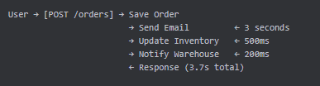
The World We Know: Synchronous Processing
User waits for EVERYTHING to finish.

Slide 4
What's Wrong with This?
Slow response — user waits 3.7 seconds for a "simple" order
Tight coupling — API knows about Email, Inventory, Warehouse
Fragile — if Email service is down → entire order fails
Hard to scale — adding a new step = changing the API code
No retry — if something fails midway, what happens?
Question: What happens to your user's experience when the email server is down for 5 minutes?

Slide 5
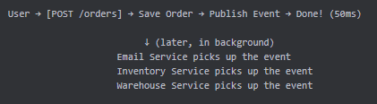
The Solution: Think Asynchronously
What if the API only did ONE thing?
Fast response
Services work independently
Failures are isolated

Slide 6
What is Messaging?
A way for applications to communicate by sending data through an intermediary (broker) instead of directly to each other.
Key Insight: The sender doesn't know (or care) who receives the message.

Slide 7
Core Concepts
Concept | What it is | Analogy
Producer | Sends messages | You dropping a letter at the post office
Consumer | Receives & processes messages | The recipient opening the letter
Queue | Holds messages until consumed | The mailbox
Broker | Routes messages to the right queue | The postal system
Exchange | Routing logic (RabbitMQ specific) | The sorting facility

Slide 8
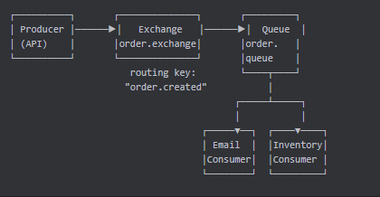
Message Flow — How It Works
Exchange receives the message → routes via routing key → delivers to Queue → Consumers compete to process

Slide 9
Exchange Types (RabbitMQ)
Type | Behavior | When to use
Direct | Routes by exact routing key match | Point-to-point, specific routing
Fanout | Broadcasts to ALL bound queues | Notifications to all services
Topic | Pattern matching on routing key | Flexible routing (e.g. order.*)
Headers | Routes by message headers | Complex routing rules
Our demo uses Direct Exchange — simplest and most common.

Slide 10
Delivery Guarantees
At-Most-Once
Message delivered 0 or 1 time
Fast, but messages can be lost
Use case: metrics, logging
At-Least-Once (Our Demo)
Message delivered 1 or more times
Reliable, but may cause duplicates
Use case: orders, payments, emails
Exactly-Once
Message delivered exactly 1 time
Very hard to achieve (requires idempotency)
Use case: financial transactions

Slide 11
When to Use Message Queues?
✅ Great for:
Email / SMS notifications
Inventory updates
Report generation
Data sync between services
Any task the user doesn't need to wait for
❌ Don't use for:
User login / authentication
Real-time queries (GET product details)
Anything that needs an immediate response

Slide 12

Architecture: Before vs After
❌ Before (Synchronous)
Coupled. Every new service = code change in OrderAPI.

Slide 13

Architecture: Before vs After
✅ After (Event-Driven)
Decoupled. OrderAPI doesn't know who listens.

Slide 14
Our Demo System
Order Processing with RabbitMQ
Component | Technology
Runtime | Java 21 + Spring Boot 3
Message Broker | RabbitMQ (Docker)
API | POST /orders
Exchange | order.exchange (Direct)
Queue | order.queue
Routing Key | order.created
Consumers | EmailConsumer, InventoryConsumer

Slide 15
What We'll See in the Demo
Fast API response — order accepted in milliseconds
Async email — processed in background (2-3 sec delay)
Inventory update — processed independently
Failure simulation — email fails randomly (30%)
Automatic retry — Spring AMQP retries up to 3 times
RabbitMQ Dashboard — see queues and messages live

Slide 16
Live Demo
Let's see it in action!

Slide 17
Key Takeaways
Decouple your services — producers and consumers don't know each other
Respond fast, process later — don't make users wait
Design for failure — retries, dead-letter queues, monitoring
Scale independently — add more consumers, not bigger servers
Extend easily — new feature = new consumer, zero changes to producer

Slide 18
Q&A
Questions?
LinhNT310@fpt.com

Slide 19
Thank You!

